Slide 1
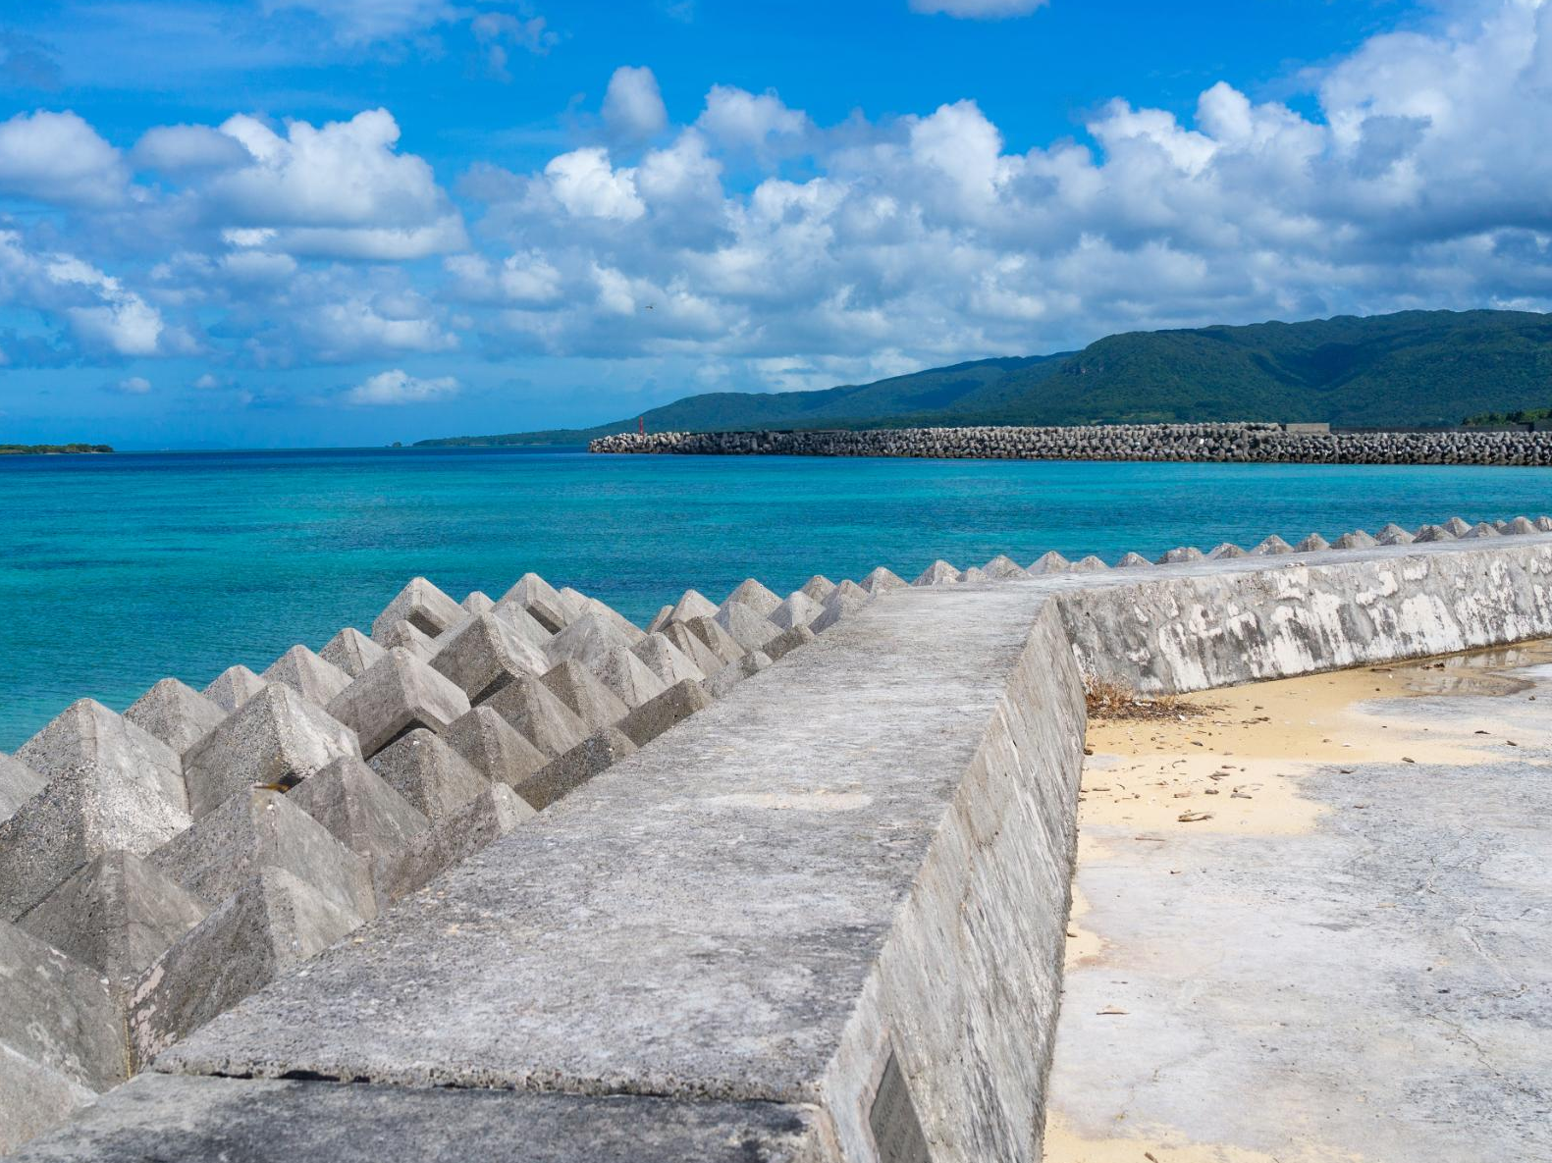
ATAR GEOGRAPHY 3.20-3.21
Kimberly Wade-Wear #19956736

Slide 2
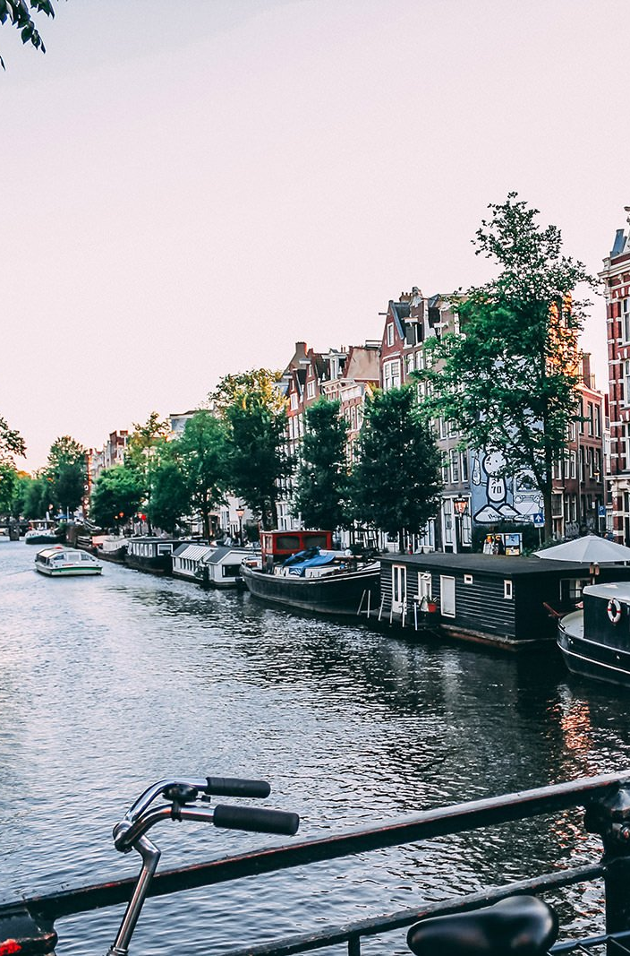
syLLABUS POINT
The current and proposed strategies, at local to global levels, implemented to mitigate the adverse effects of either global climate change or loss of biodiversity
How human activity has adapted, or may be required to adapt, to either global climate change or loss of biodiversity

Slide 3
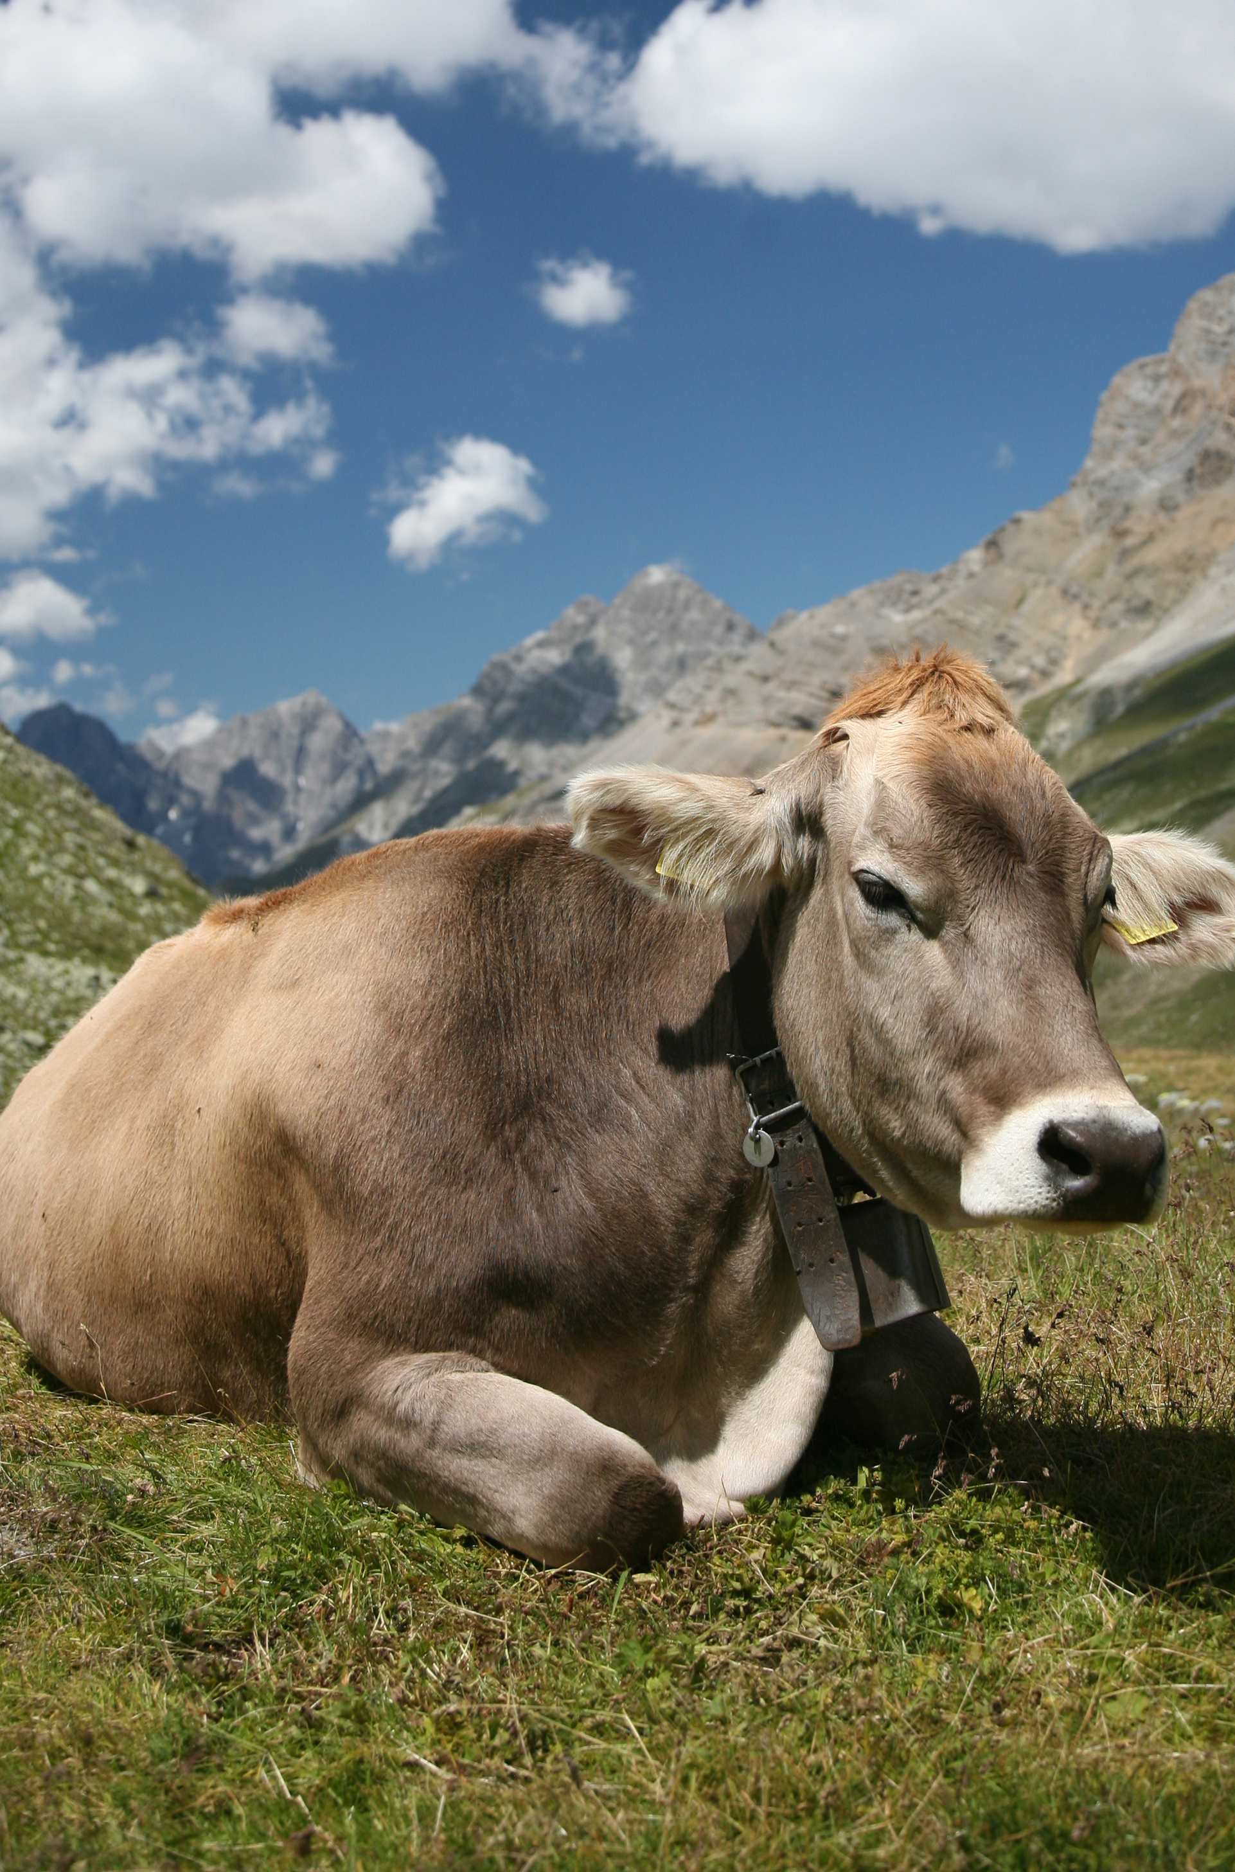
Reducing the adverse effects
A dairy cow can produce up to 600 grams of methane per day.
The Aust department of Agriculture, Fisheries and Forestry found that plant extracts of eremophila glabra have the most potent anti-methanogic properties with the effects persisting over several weeks with cattle.
Studies are now being done on it’s effect of reducing methane emissions in sheep.

Slide 4
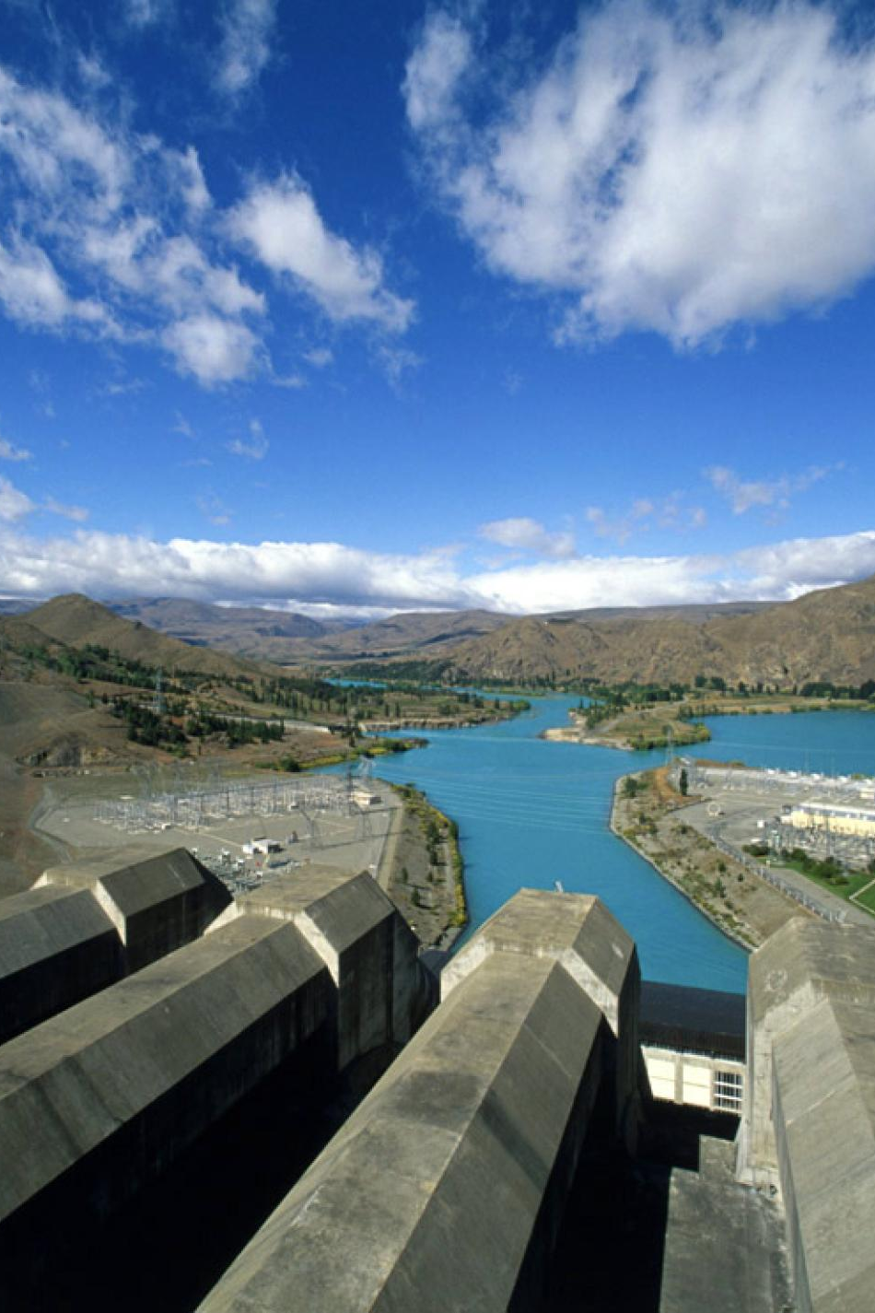
Reducing the Adverse Effects
Approx 90% of Tasmania’s energy needs are supplied by renewable energy sources.
The Snowy Mountains hydroelectric scheme produces around 3800 megawatts of renewable energy annually.
The three Gorges Dam in China is the world’s largest hydroelectric project and is able to produce 22,500 megawatts annually.
Countries like Brazil, Paraguay and Norway have at least 85% of their electricity produced from flowing water.

Slide 5
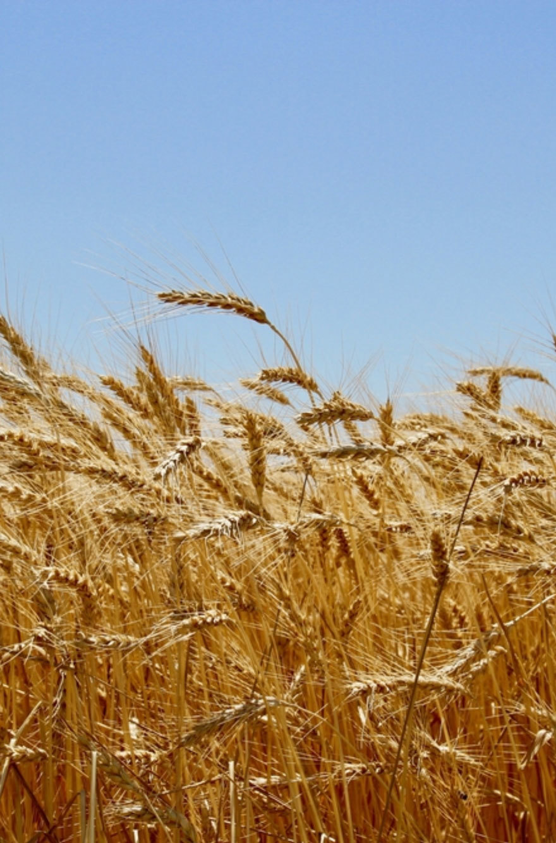
aDAPTATION
As the climate changes there will be a need for agriculture to adapt to new conditions.
The impact of probable reduced rainfall has seen the development of drought tolerant wheat species through genetic modification.
In Australia drought tolerant wheat species of wheat (Drysdale, Rees, Waagan) are being employed.

Slide 6
Adaptation
Livestock suited to drier conditions are now being used. The Ankole-Watusi is a breed of cattle that can survive on limited quantities of food and water and will graze on poor quality forage.
To combat rising sea levels and more frequent storm surges there will be a need to construct seawalls, levees and barriers. The Thames Barrier (U.K) and the Oosterschelekering (Netherlands) are examples of these that have been constructed to prevent flooding as a preventative measure against rising sea levels.

Slide 7
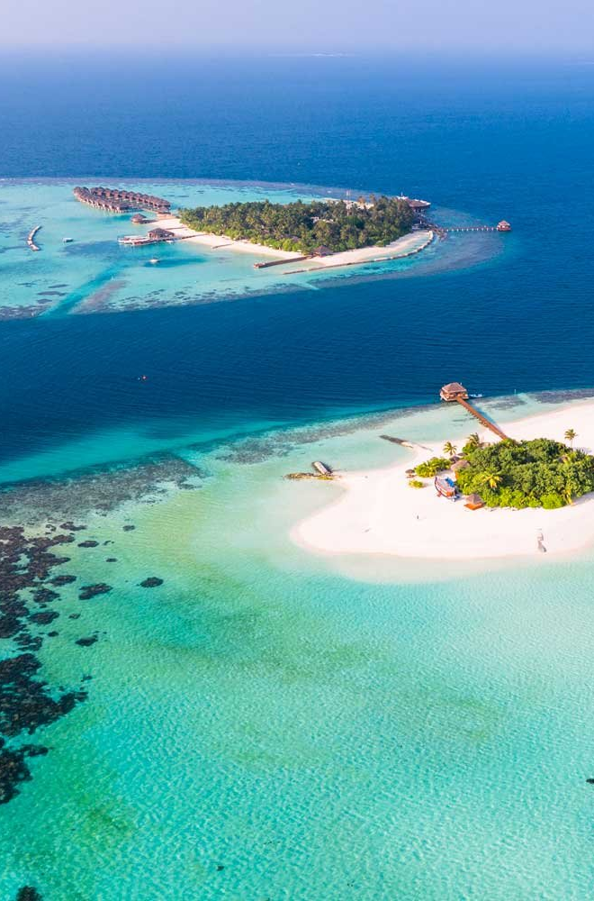
Adaptation
Advanced nations will have greater capabilities to adapt. Populations of some low-lying island groups threatened by rising sea levels (Kiribati, Tuvalu, Maldives) are likely to relocate due to their poor inability to adapt.

Slide 8
Human activity
The development of strains of drought tolerant Maize has already boosted harvests in 13 African countries by between 10-34%.
The Maldives is the lowest country in the world with a highest point of only 2.4 metres. A 2m seawall has been built around Malé, its capital city and one of the most densely populated cities of the world.
They have also reclaimed land and made the new island Hulhumalé that is 2m above present day sea levels and higher then the majority of the islands of the archipelago nation as an adaptation to future rising sea levels.

Slide 9
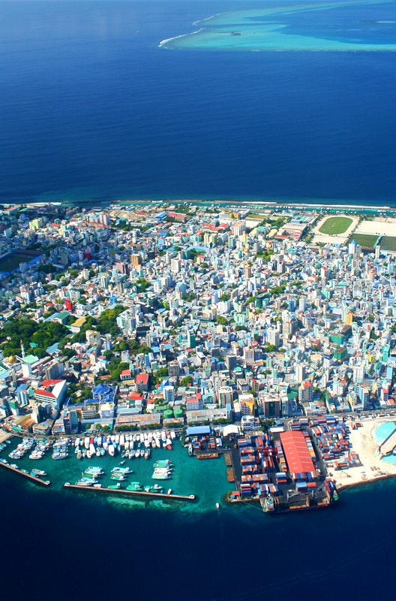
Human activity
There are over 18,000 desalination plants around the world that provide water to over 300 million people.
Approx 50% of these are in the Middle East and the largest is the Ras-Al-Khair in Saudi Arabia which has the capacity to produce over 700 million litres of potable water a day.

Slide 10
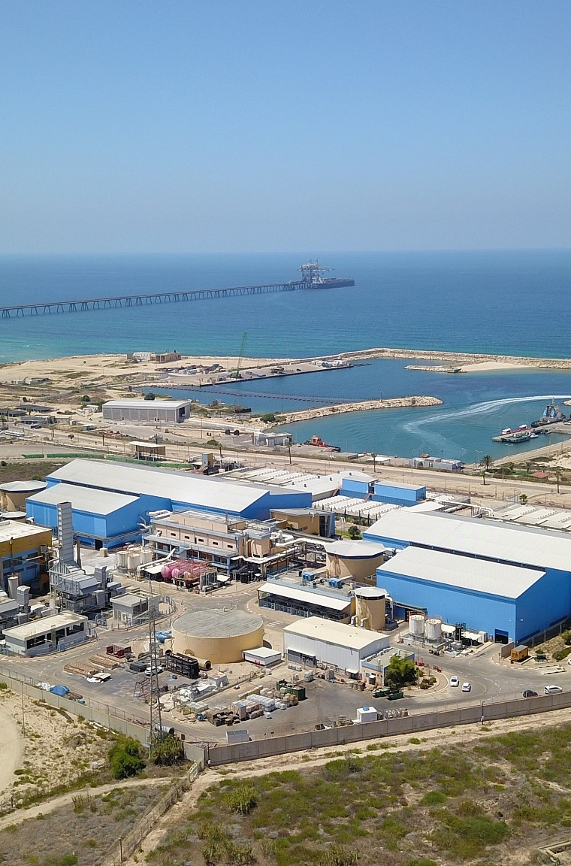
Human Activity
Israel currently leads the world in the proportion of it’s water that’s recycled. All the sewage from the Tel Aviv Metropolitan area is recycled and used as irrigation water.
With Chicago expected to become hotter and wetter, policies have been developed in regards to repairing roads and pavements with permeable materials to improve drainage and offering tax incentives to encourage green office roofs that will help keep rainwater out of overburdened sewer systems.

